Slide 1
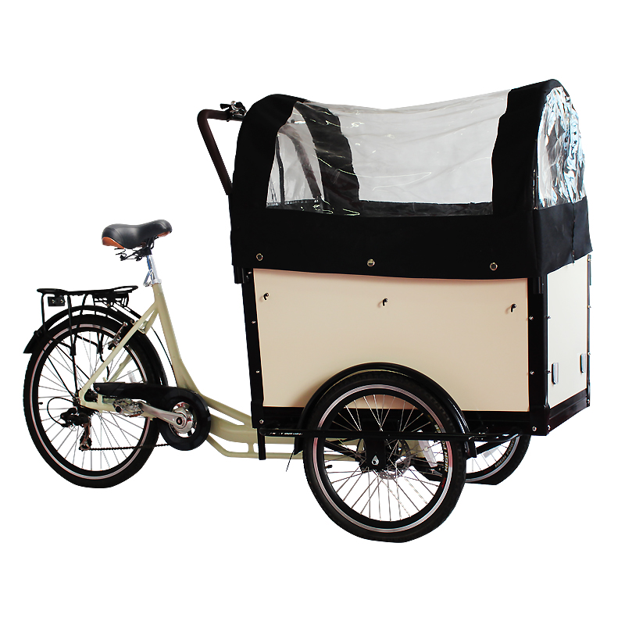
Price my bike!
Quickly pricing your used items
Bruno Afonso, insight fellow

Slide 2
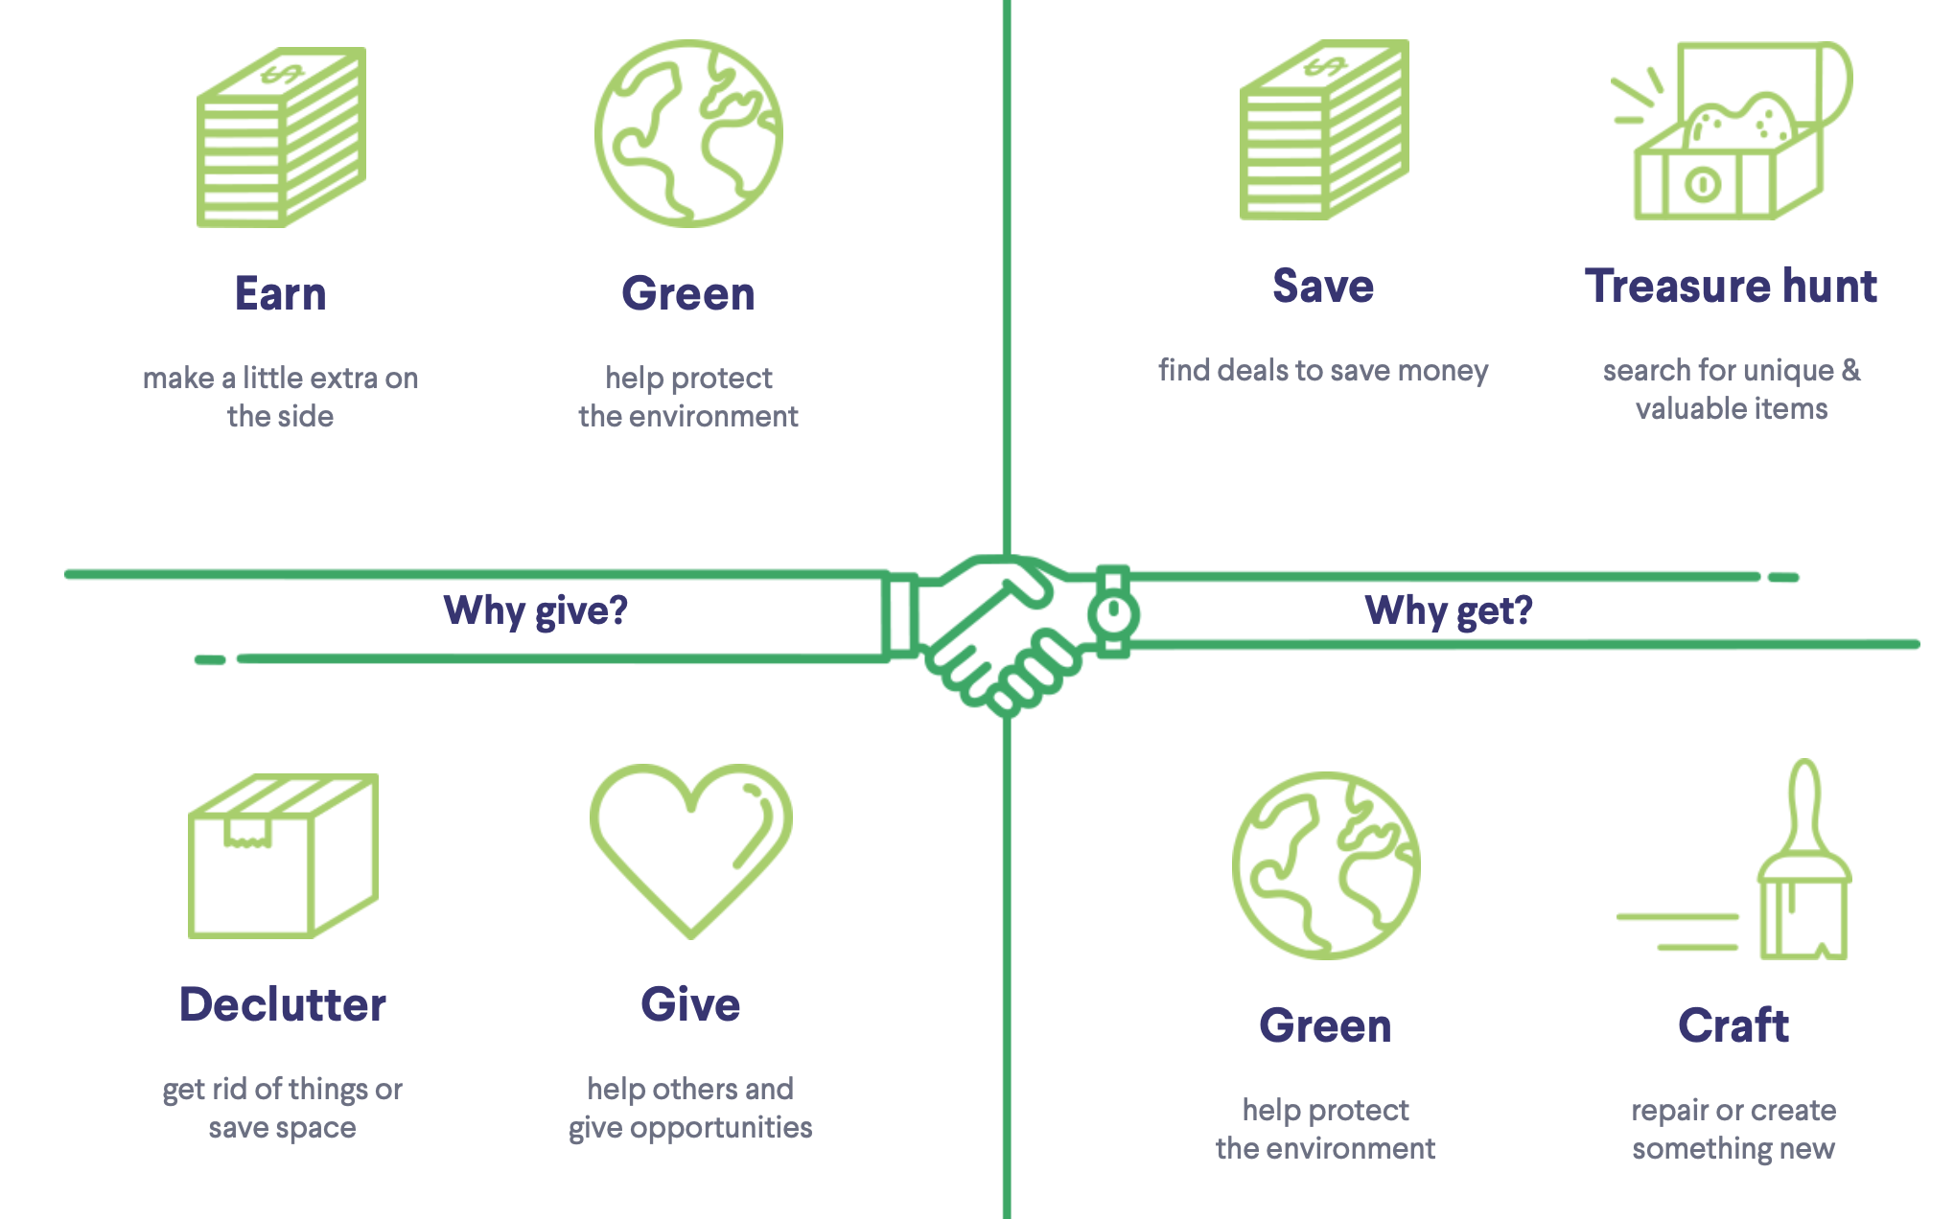
used and second-hand goods industry is booming
Environmental concerns have driven people to the used market
Canadian second-hand economy was 28.5B CAD (2018)
Most Canadians take part in the second-hand economy
82% (2016)
85% (2018)

Slide 3
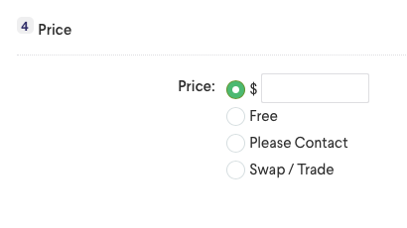

Pricing used items is hard… can we suggest a price?
If only I could quickly price the stuff I want to “declutter” …
Suggested price:
200

Slide 4
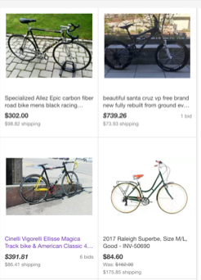
Example market: used bikes
Bicycles are hard to price given the number of parts and wide range of quality
Wheels: from $50 to $2000
eBay completed sales with final transaction price
Backlog of 90 days (~14k)

Slide 5
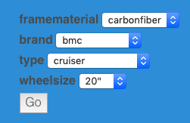
Automated pipeline
Feature engineering
Data acquisition
Data cleaning
Model building
Web app
eBay API
Mongo DB
Python
Scikit-learn
NLP
Automated feature estimation
Flask
AWS
Automatically generated website
{'AutoPay': 'true',
'BestOfferEnabled': 'false',
'BidCount': '27',
'BuyItNowAvailable': 'true',
'BuyItNowPrice': {'_currencyID': 'USD', 'value': '149.99'},
'ConditionDisplayName': 'Used',
'ConditionID': '3000',
'ConvertedBuyItNowPrice': {'_currencyID': 'USD', 'value': '149.99'},
'ConvertedCurrentPrice': {'_currencyID': 'USD', 'value': '69.0'},
'Country': 'US',

Slide 6
data pipeline
Data acquisition
'ItemSpecifics': {'NameValueList’:
[{'Name': 'Wheel Size',
'Value': '26"'},
{'Name': 'Model',
'Value': 'Hard Rock'},
{'Name': 'Suspension',
'Value': 'No Suspension'},
{'Name': 'Handlebar Type',
'Value': 'Flat Bar'},
{'Name': 'Number of Gears',
'Value': '21'},
{'Name': 'Frame Size',
'Value': '53cm (21")'},
{'Name': 'Type',
'Value': 'Mountain Bike'},
{'Name': 'Features',
'Value': ['Rear Rack',
'Adjustable Seat']},
{'Name': 'Color', 'Value': 'Red'},
{'Name': 'Frame Material',
'Value': 'Steel'},
{'Name': 'Brand',
'Value': 'Specialized'},
{'Name': 'Brake Type',
'Value': 'Cantilever'},
{'Name': 'Manufacturer Color',
'Value': 'Fire Engine Red'},

Slide 7
data pipeline
Data acquisition
Data cleaning
{'AutoPay': 'true',
'BestOfferEnabled': 'false',
'BidCount': '27',
'BuyItNowAvailable': 'true',
'BuyItNowPrice': {'_currencyID': 'USD', 'value': '149.99'},
'ConditionDisplayName': 'Used',
'ConditionID': '3000',
'ConvertedBuyItNowPrice': {'_currencyID': 'USD', 'value': '149.99'},
'ConvertedCurrentPrice': {'_currencyID': 'USD', 'value': '69.0'},
'Country': 'US',

Slide 8
data pipeline
Feature engineering
Data acquisition
Data cleaning
Model building
Web app
Topic modeling
{'AutoPay': 'true',
'BestOfferEnabled': 'false',
'BidCount': '27',
'BuyItNowAvailable': 'true',
'BuyItNowPrice': {'_currencyID': 'USD', 'value': '149.99'},
'ConditionDisplayName': 'Used',
'ConditionID': '3000',
'ConvertedBuyItNowPrice': {'_currencyID': 'USD', 'value': '149.99'},
'ConvertedCurrentPrice': {'_currencyID': 'USD', 'value': '69.0'},
'Country': 'US',
Random forest
regressor

Slide 9
Predicting the price
Features from eBay listing
'ItemSpecifics': {'NameValueList’:
[{'Name': 'Wheel Size',
'Value': '26"'},
{'Name': 'Model',
'Value': 'Hard Rock'},
{'Name': 'Suspension',
'Value': 'No Suspension'},
{'Name': 'Handlebar Type',
'Value': 'Flat Bar'},
{'Name': 'Number of Gears',
'Value': '21'},
{'Name': 'Frame Size',
'Value': '53cm (21")'},
{'Name': 'Type',
'Value': 'Mountain Bike'},
{'Name': 'Features',
'Value': ['Rear Rack',
'Adjustable Seat']},
{'Name': 'Color', 'Value': 'Red'},
{'Name': 'Frame Material',
'Value': 'Steel'},
{'Name': 'Brand',
'Value': 'Specialized'},
{'Name': 'Brake Type',
'Value': 'Cantilever'},
{'Name': 'Manufacturer Color',
'Value': 'Fire Engine Red'},

Slide 10
Predicting the price
Features from eBay listing
'ItemSpecifics': {'NameValueList': [{'Name': 'Wheel Size',
'Value': '26"'},
{'Name': 'Model',
'Value': 'Hard Rock'},
{'Name': 'Suspension',
'Value': 'No Suspension'},
{'Name': 'Handlebar Type',
'Value': 'Flat Bar'},
{'Name': 'Number of Gears',
'Value': '21'},
{'Name': 'Frame Size',
'Value': '53cm (21")'},
{'Name': 'Type',
'Value': 'Mountain Bike'},
{'Name': 'Features',
'Value': ['Rear Rack',
'Adjustable Seat']},
'CurrentPrice': {'_currencyID': 'USD', 'value': '332.46'},
'Description': '#2379: Specialized Hard Rock Vintage Mountain Bike X'
'Large 21" MTB Suntour XC Charity!A classic MTB model'
'which leaves you ripping the trails this summer! '
'Very durable rigid steel MTB/touring/commuting bike.'
'Brand: SpecializedModel: Hard RockSize: 21in ctt '
'19.5in ctcTop Tube: 22.5inStandover: 30.5inFrame '

Slide 11
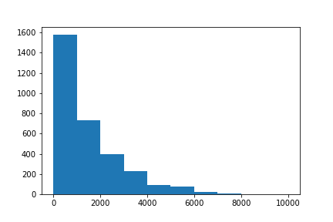
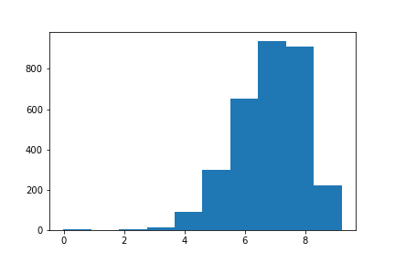
pipeline challenges
Missing data due to spelling or lack of input from users poses a problem (high sparsity matrix)
Simplifying text to correct most common mistakes people make
Estimating novel categories using NLP
Price distribution is not normal.
Original prices
Log(price)

Slide 12
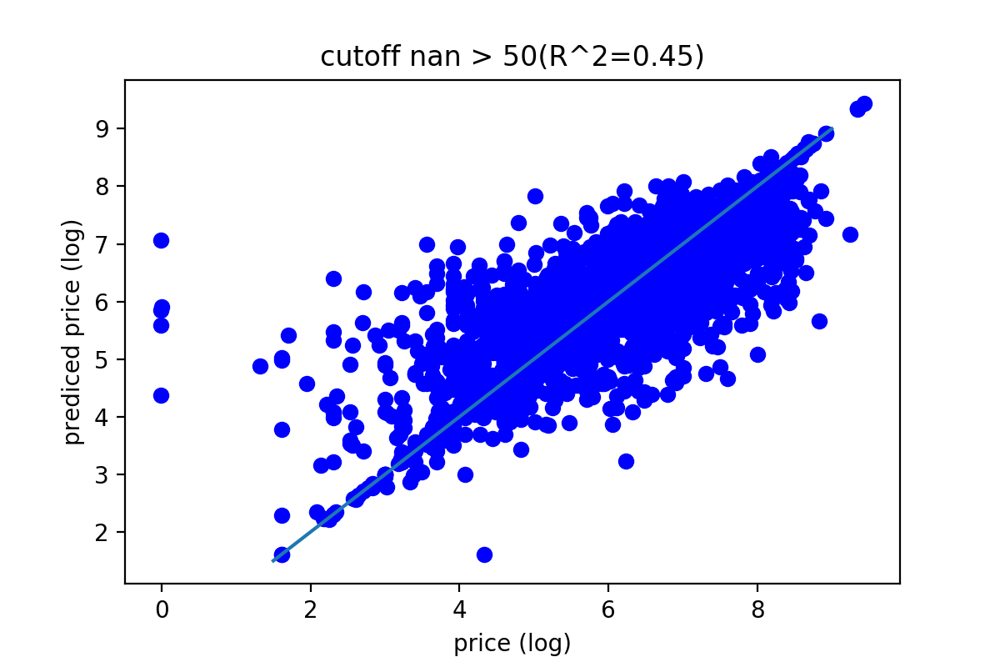
Pricing model
Random Forest Regression
Extracted 4 categorical features
14k original entries, only 3k have no missing values
Training 80%
Test 20%
Replaced all missing values for “other”
R² = 0.445

Slide 13

Pricing model with nlp
Random Forest Regression with NLP
Extracted 4 categorical features
14k original entries, only 3k have no missing values
Training 80%
Test 20%
6 new features based on topic modeling (NLP)
R² = 0.66

Slide 14
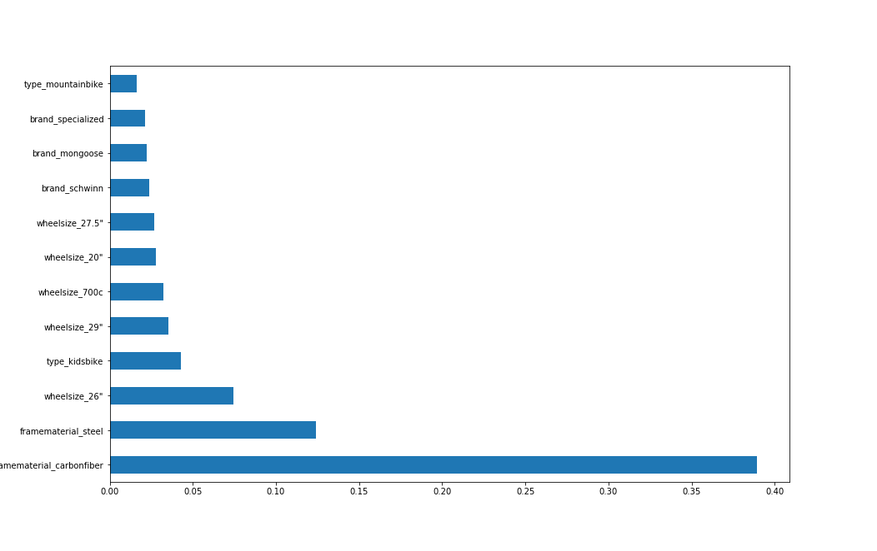
Feature importance

Slide 15
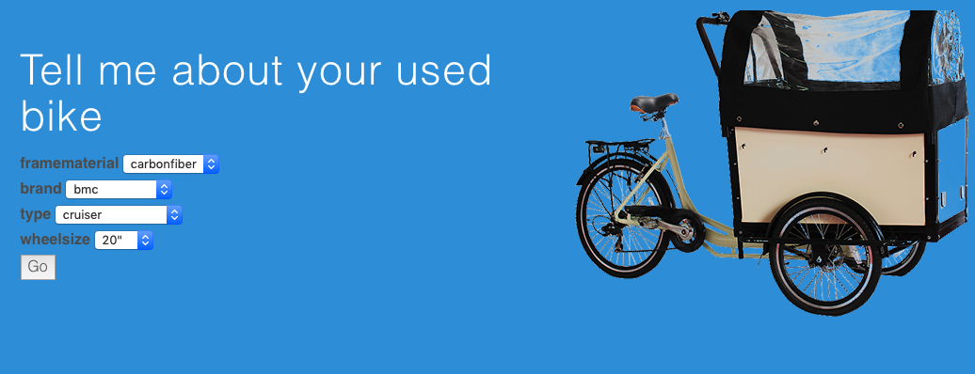
Demo !
Price my Bike Demo time !

Slide 16


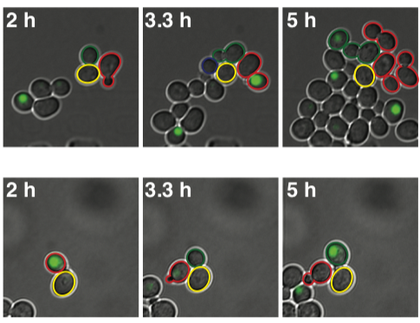
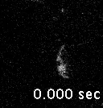
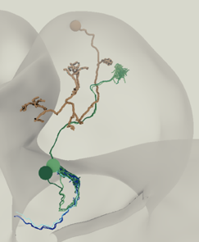
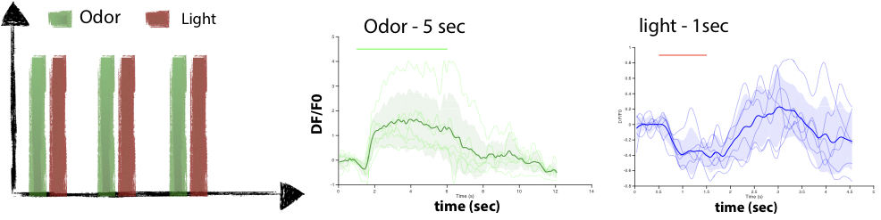
Bruno afonso
I like data
I love noisy data

Slide 17
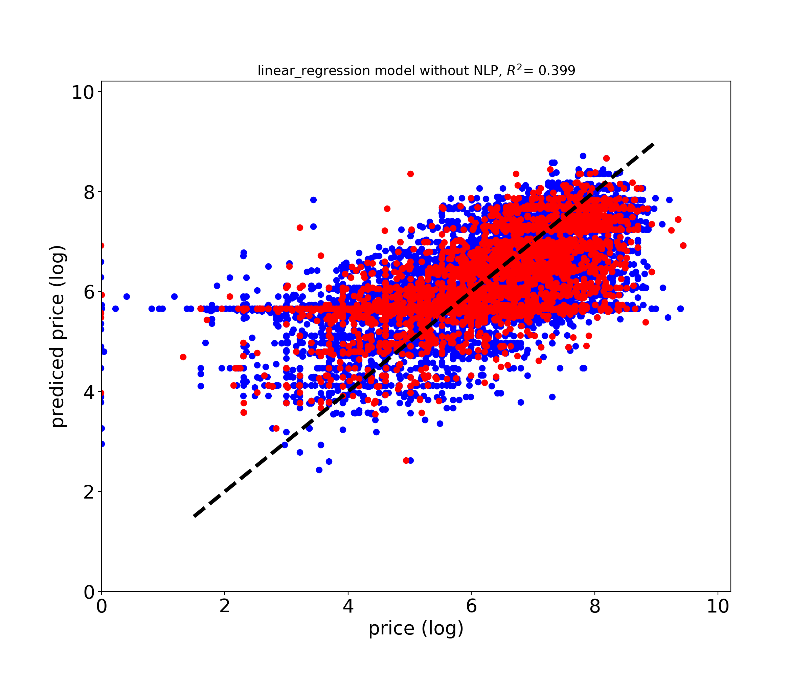
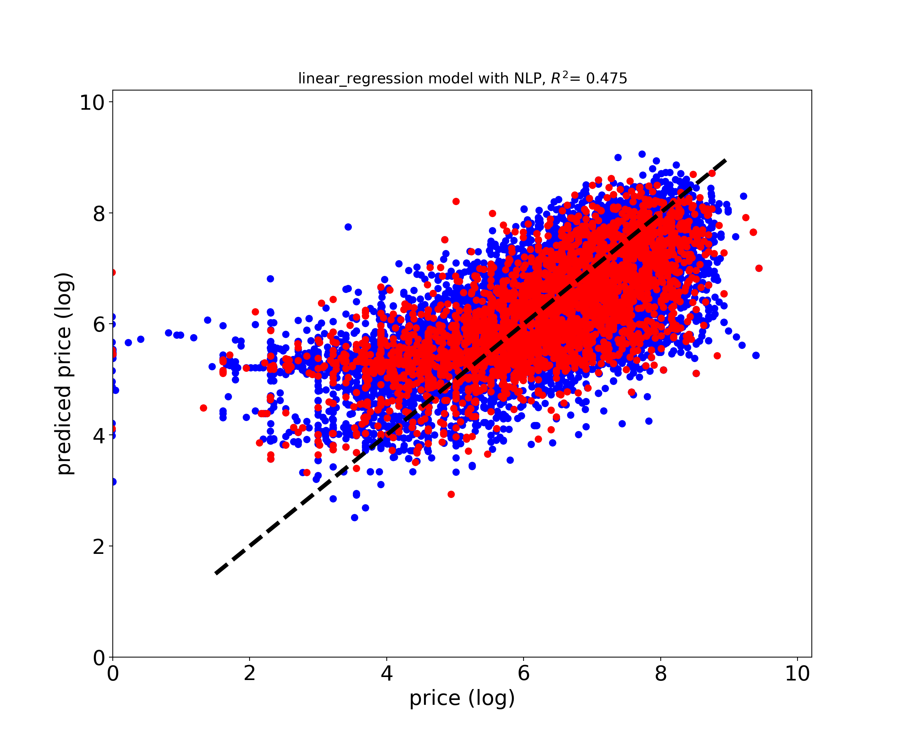
Other regressions: linear

Slide 18
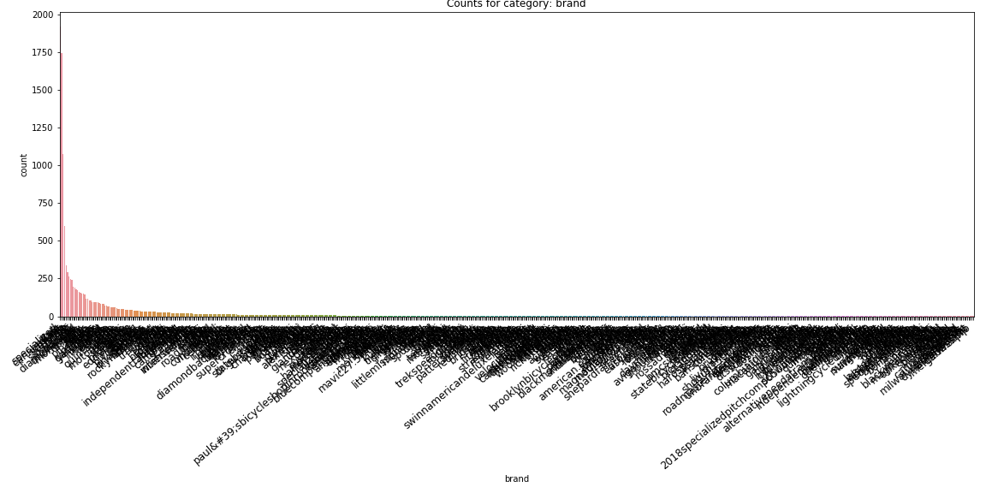
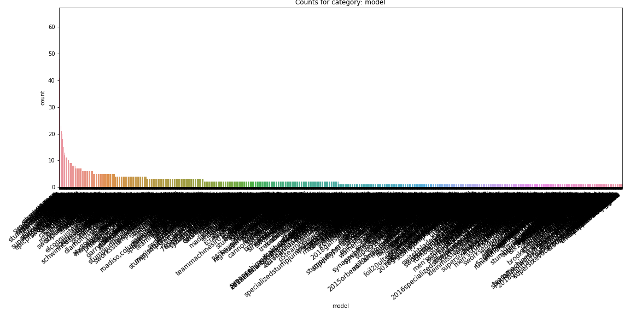
Categories distributions
Brand
model

Slide 19
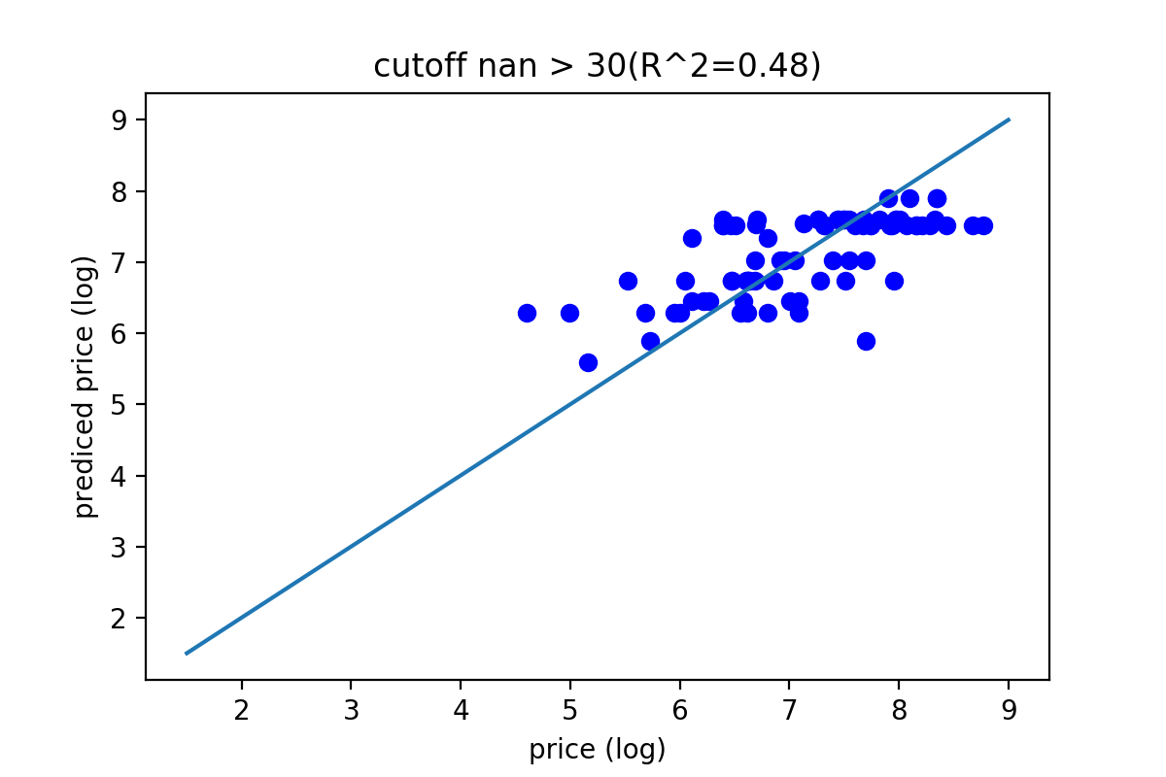
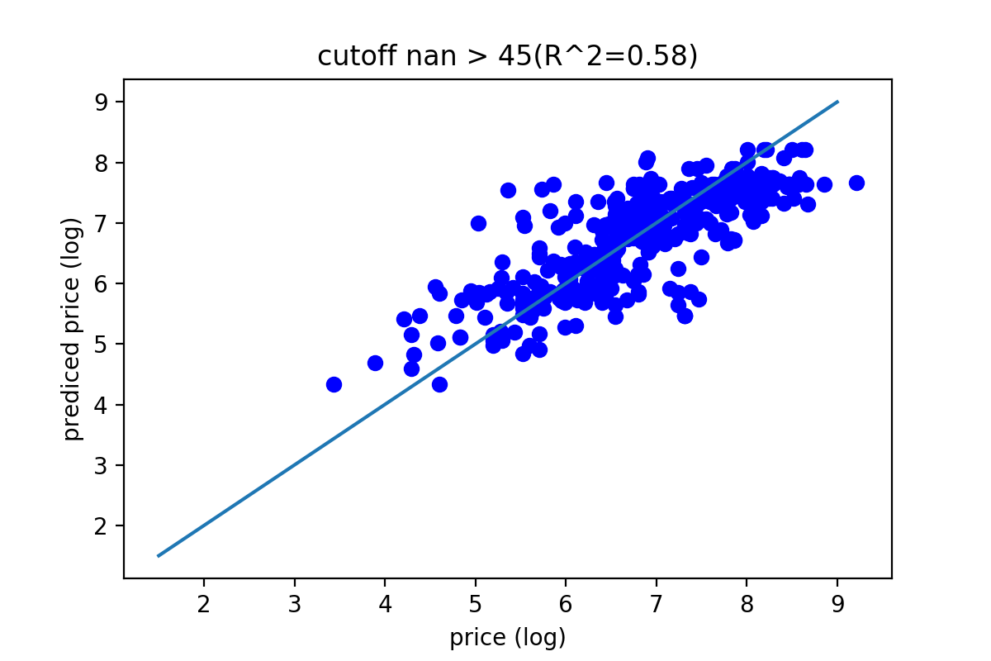
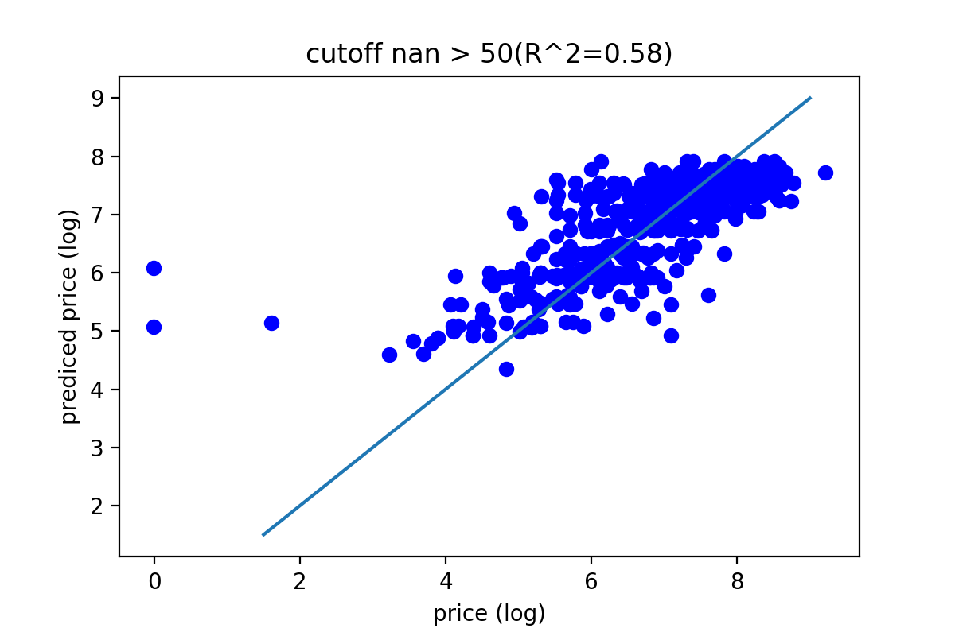
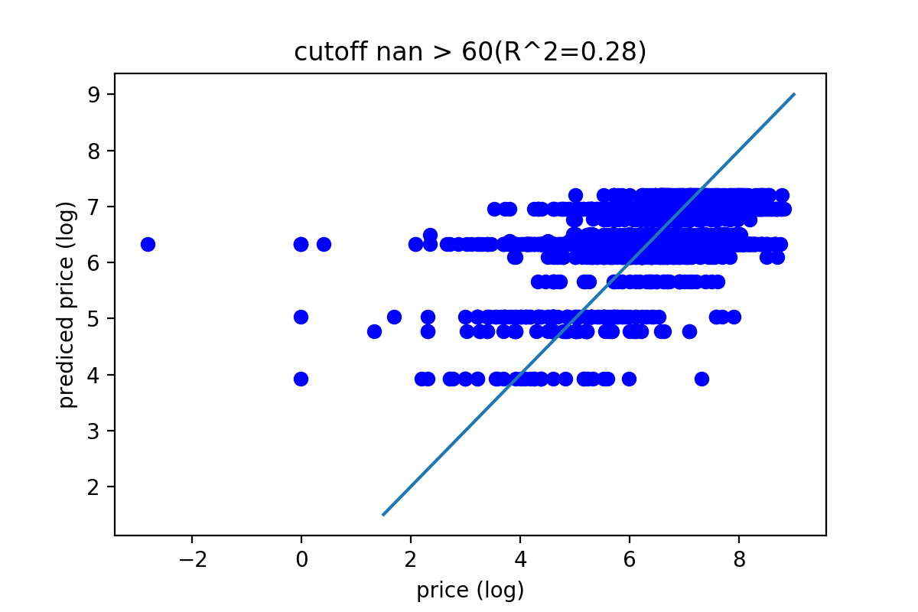
Dropping missing values effect

Slide 20
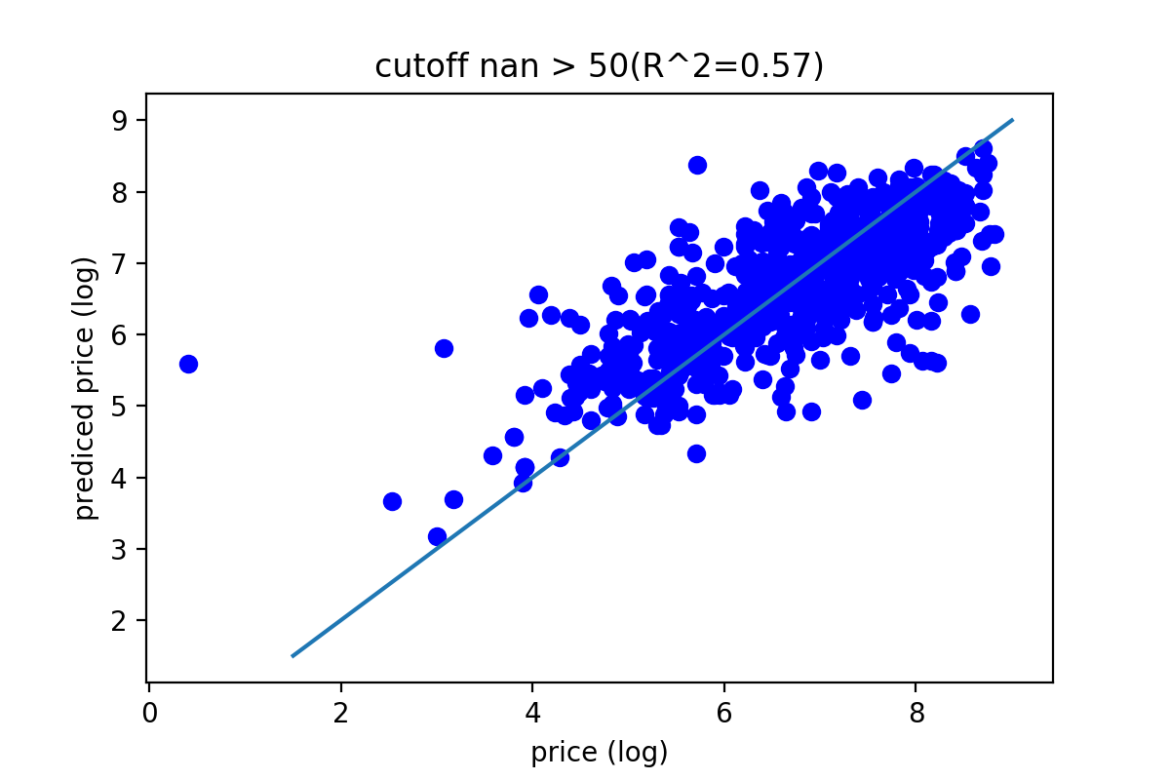
Replacing lower represented labels with “other”
Simply dropping them
“other”

Slide 21
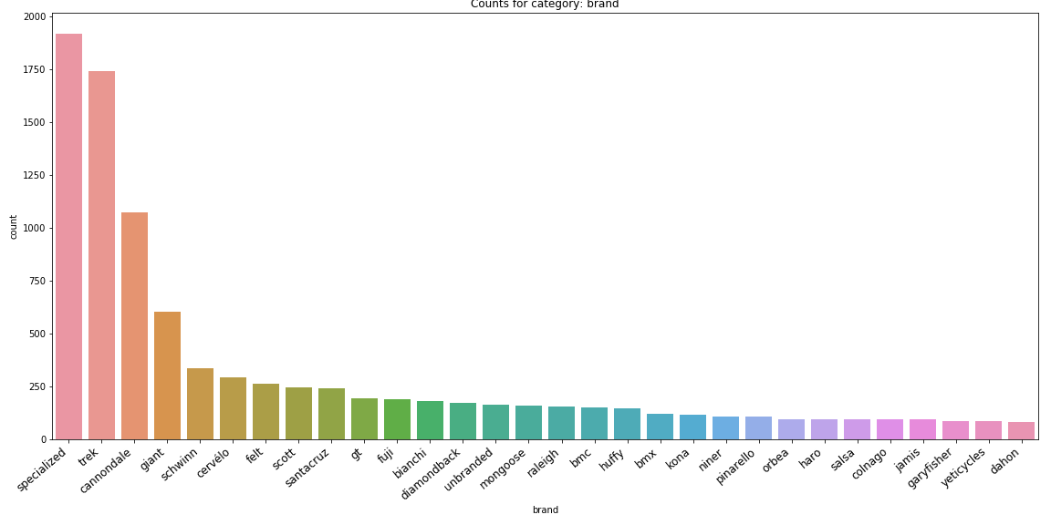
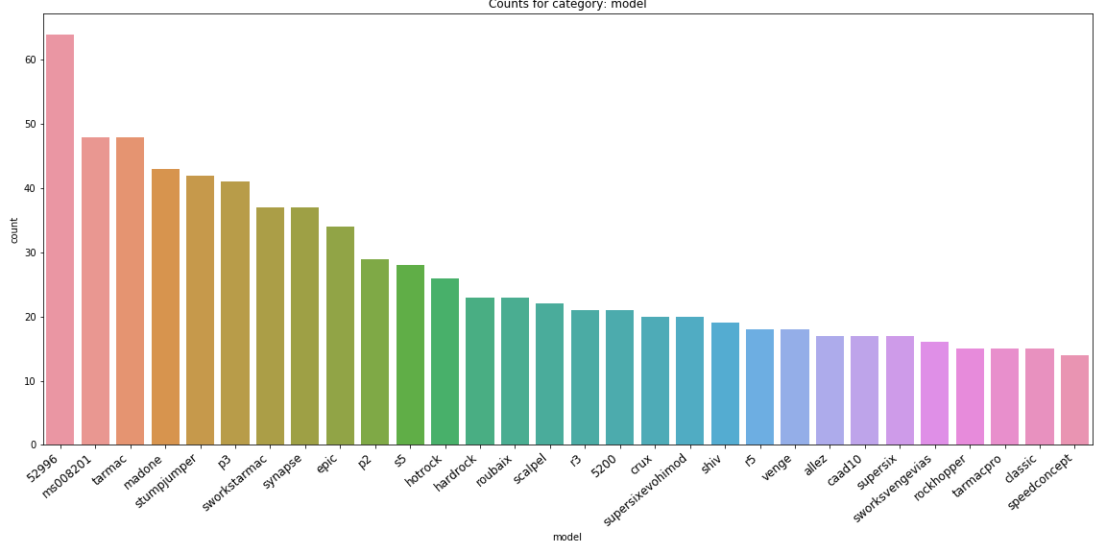
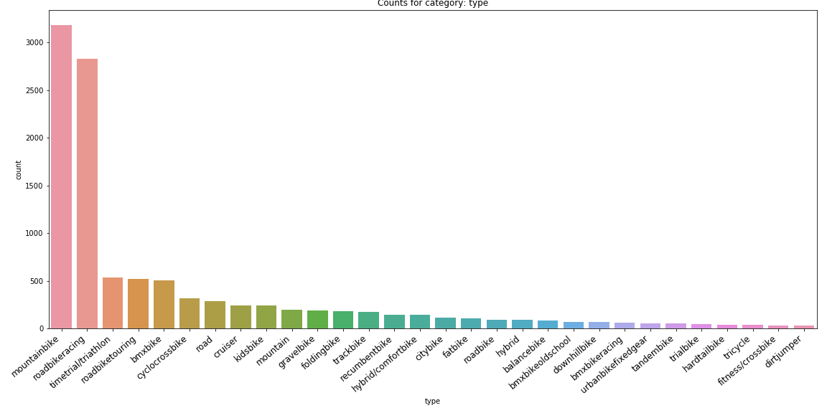
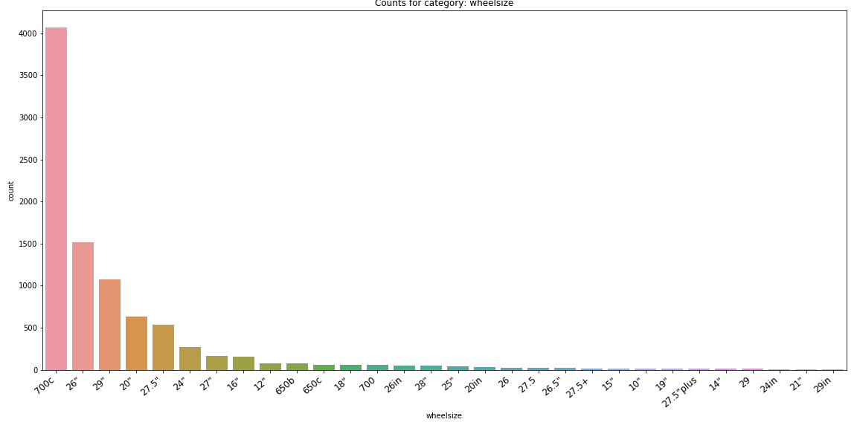
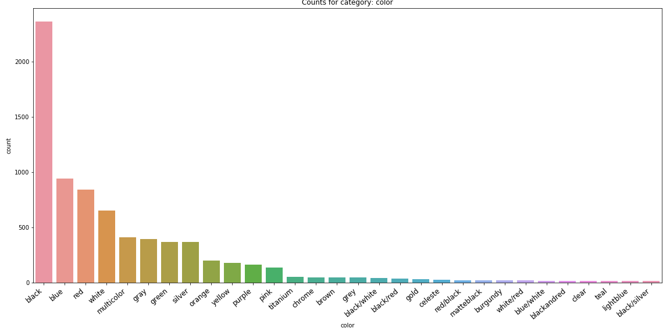
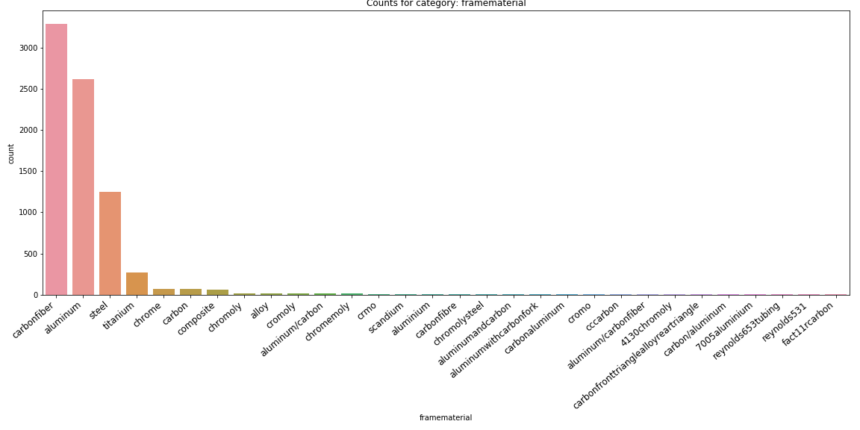
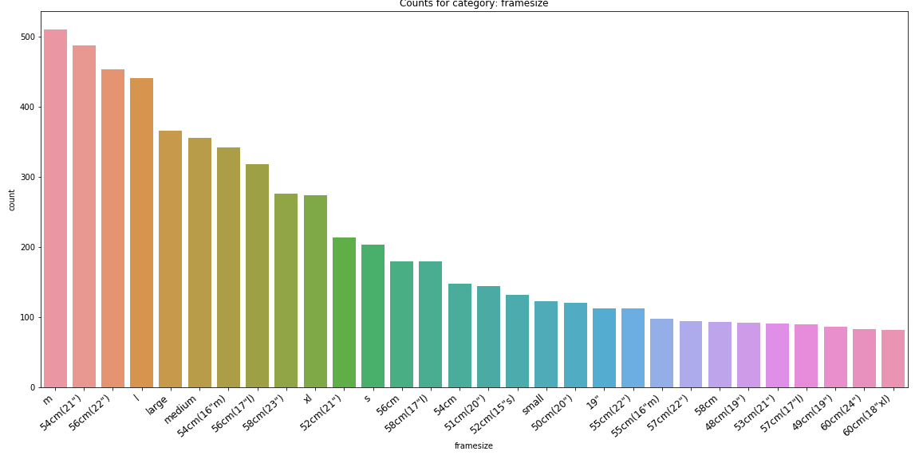
Category distributions

Slide 22
